Slide 1

Making Collaborative Governance Sustainable: A Developmental Lifecycle Approach
9 March 2023
Shinjini Mondal MPH, PhD
OHT Impact Fellow

Slide 2

Session Outline
Part I
Introduction: 10 minutes
Brief Presentation: 15 minutes
Part II
Panel Discussion: 20 minutes
Part III
Q & A : 10 minutes
Vote of Thanks: 5 minutes

Slide 3
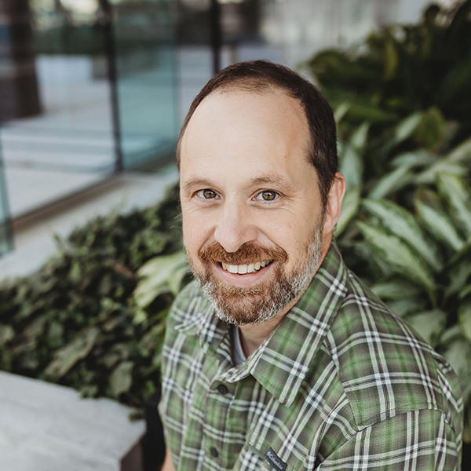





Jeff Wingard
Lindsay Wingham Smith
Anne Wojtak
Senior Manager,
Lead ETHP
Development & Partnerships

Slide 4

Collaborative governance & networks
Collaborative/network governance includes processes, structures, and dynamics of decision-making and coordination & cooperation
Better coordination & integration
Promotes participatory forms of governance
Brings together diverse participants
Generate relevant solutions with lasting impact on the community
Dynamic, time-consuming, & fraught with difficulty
Diversity of stakeholders, conflicting goals among members
Asymmetry of power and information
Notes:
Collaborative/network approaches promise
better coordination and integration ^{(Bingham and O’Leary, 2008)},
promoting participatory forms of governance and bringing together diverse participants to create relevant solutions and lasting impact on the community (Cooper et al., 2006; Leach and Sabatier, 2005)
Collaborative/network governance challenges
dynamic, time-consuming, and fraught with difficulty (Bardach 1998; Johnston et al. 2010; Ospina & Saz-Carranza 2010; O’Leary & Bingham 2009)
diversity of stakeholders, conflicting goals among members, and asymmetry of power and information ^{(Smith, 2020)}

Slide 5





Integrated Care Governance
Networks governance conceptualization
Dynamic & Evolving
Lack of best practices
Factors for network governance- facilitation, leadership, building relationships and trust

Slide 6
Research: Aim & Process
Aims of the study:
  Understand
  Conditions and suitability of structure for shared decision-making
  Efforts toward evolving governance structures and/or processes
  Provide a comparative understanding of governance structures & processes across OHTs
Five Cohort one OHT selected
variation in geography (rural/semi-rural/urban)
attributable population
Interviews (29) with leadership council members from acute care, primary care, community organizations and patient/family/caregiver representatives

Slide 7
Areas of Enquiry
Evolution & Process adapted
1) Initial process of engagement/
participation
2) Role of leadership
3)CDMA development
Current Governance structure
1) Leadership’s Council-current decision-making
2) Current Governance arrangement
3)Pros and Cons
4)Representation/Trust/ Inclusion
5)Power sharing equal voice
6)Partner Board Engagement
Future active efforts
1) Updating/evolving governance structure
2) Provincial support/direction
Notes:
Interesting themes emerging- Integration of OHTs, Capacity and support for patient/caregivers, Primary care providers (non-executive), engagement of partner boards in two OHTs

Slide 8



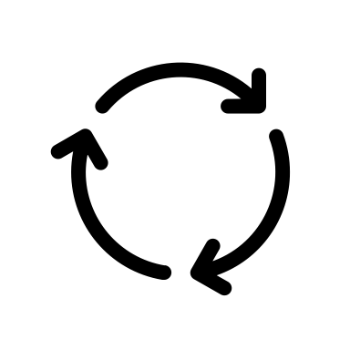
Key Findings
Trust and relationships
Leadership (steering & consensus building)
Complex & evolving decision-making
Multiphase journey (continuous development approach)
Notes:
Trust and relationship building are key facilitators
Relationships & trust are key to moving forward
Fair and transparent processes
Decision-making agreements are complex and evolving
OHTs have not really had significant tests of shared vision (performance measurement, financial allocation, and project/program prioritization)
Clarity on decision-making levels
Balancing efficiency and inclusive decision-making challenging
Balancing sectoral representation and skills at the leadership council
Timely, swift, efficient & inclusive decision-making
Leadership (individual/council level) provides steering and navigating consensus building
Transformational leadership, facilitation and consensus role
Governance is a Multi-phase journey with a continuous development approach

Slide 9





Network Governance Developmental Life Cycle
Recreation/ Reorientation
Provincial Policy Context
Incremental Gain
Activation
Collectivity
Stability, Decline or Reorientation
Focus on reorientation/re-creation of the network
Incremental adjustments in rules, routines, and procedures to improve service delivery
The initial phase of network formation involves bringing people together, setting goals
Fluid processes rely on cooperation
Rules for structuring network processes using formal processes
Decision-making streamlined
Distributed leadership
Capacity to innovate & adapt
Build trust & relationships, membership clarity
Focus on what to do & how to do
Equal participation & High cohesion
Institutionalization

Slide 10
Building trust & relationships
Relationships & trust are key to move forward [primary care & community sector]
COVID success stories of joint working arrangement
History of working together OR trust creation from participation- “safe space”
“it’s all the about the process”
“opportunity to come together to form new relationships”

Slide 11
Evolving decision-making agreement
Revision of decision-making agreement allowing complex decision-making
Balancing sectoral representation and skills at the leadership council [Inclusive & efficient]
“But what we found now, as we get more sophisticated, and as the work gets more intense, and we are getting closer to making more complex decisions about integrated care delivery, and resource allocation, is that the consensus model has limitations. Because we may not agree now, or the decisions may have more nuances that, you know, just a straight consensus doesn't make sense. So this is one of the things that we're looking at. And we've been testing some different decision-making frameworks to help support making more complex decisions” (OHT03_Leader)
Notes:
(performance measurement, financial allocation, project/program prioritization)

Slide 12
Leadership & steering
Distributed leadership: leadership council to focus on strategy
(building distributed leadership)
“I would say that there are some key leaders on the Executive Council that played a real pivotal role in getting here, for example, X and Y. I think that, you know what, there’s just a different group of individuals who are really collaborative, and wanted to try something that was going to establish us and I think it took a team of people around the table. It was based on the principles of whether it is equitable, fair, and eventually be more inclusive.” (OHT 01_Leader)
“I will say the other key piece I think about is developing leaders for the future. And especially with an Idea of Diversity and Inclusion, I think oftentimes, people get an opportunity to sit in a committee are our leaders, whether it’s the full leader of an organization or the manager, and others get an opportunity to see how things work. And it's an opportunity to lift up leaders and to start preparing some succession and get better visibility.” (OHT05_Leadership Council member)
Notes:
Leadership is critical in bringing sectors and partners together
Steering discussion and building consensus
Leadership style-Transformational (collaborative, encouraging, motivational, innovative)

Slide 13
Panel Discussion

Slide 14

1. Importance of building trust (literature & research)
As leaders, what has been your experience around building trust and relationships? Are there any associated challenges?

Slide 15
2. OHTs have a collaborative governance model and many OHTs are in the process of expanding their leadership/governance council
Can you share some highlights and guiding principles for the process? How did you balance inclusive (sectoral) representation and efficient (skills-based) decision-making?

Slide 16
3. Recent Governance Guidelines have identified a new model of governance.
As OHT leaders, how are you planning to take the steps toward evolving the governance model?

Slide 17
4.“The developmental life-cycle approach promotes cyclical thinking to evolve governance than following a linear path. In your OHT journey, which quadrant do you identify the most and whether this continuous development approach resonates with your experience?”

Slide 18



Acknowledgements
Panellists & study participants
OHT mentors (Prof. Walter Wodchis, Tess Romain, Lindsay Wingham Smith)
OHT Fellowship Team & Fellows
Ministry of Health
Contact: shinjini.mondal@utoronto.ca

Slide 19
Upcoming Webinar
Friday March 24th from 12:00-1:30pm-Engaging Primary Care – From the Inside Out
In this webinar, panelist pairs will talk about their experiences and share their learnings on engaging clinicians in two important ways. In the first half Dr. Morrison and Dr. Charles will answer rapid-fire questions asked by the Fellows related to engaging primary care in leadership. In second part, the OHT Fellows will address engaging primary care and incorporating their feedback in integrated care solutions and planning. They will each share a short case study and cast light on: The context and rationale for reflecting the primary care voice in integrated care solutions

