Slide 1

Supported Attachment Guidance & 2025/26 In-Year TPA Amendment Webinar
December 9, 2025

Slide 2

Land Acknowledgement

Slide 3

Webinar Logistics
  This session will be recorded and a link to the recording will be circulated post meeting, along with meeting materials and the Health Care Connect Guidance document.
  Please hold your questions until the Q&A portion.
    Questions can be submitted through the Q&A box:
    Due to limited time, unanswered questions should be advanced to your OH regional point of contact.

Slide 4
Agenda
TIME | TOPIC | NAME
5 mins | Land Acknowledgement Webinar Logistics | Meaghan Cunningham, Director, OHT Implementation, Ontario Health Fredrika Scarth, Vice President, Integrated Care, Ontario Health
10 mins | Opening Remarks | The Honourable Sylvia Jones, Deputy Premier and Minister of Health Betty-Lou Kristy, Chair for the Minister's Patient and Family Advisory Council Dr. Sacha Bhatia, Executive Vice President, Primary & Community-Based Care, Ontario Health
20 mins | Overview of Supported Attachment Guidance | Fredrika Scarth, Vice President, Integrated Care, Ontario Health Dr. Brian McKenna, Regional Primary Care Clinical Lead, Ontario Health
5 mins | Overview of the 2025/26 OHT TPA Amendment | Fredrika Scarth, Vice President, Integrated Care, Ontario Health
18 mins | Facilitated Q&A | Facilitator: Meaghan Cunningham, Director, OHT Implementation, Ontario Health Panelists: Allison Costello, Director, OHT Policy and Operations Branch, Ministry of Health Fredrika Scarth, Vice President, Integrated Care, Ontario Health Dr. Brian McKenna, Regional Primary Care Clinical Lead, Ontario Health Aruna Mitra, Director, Patient Services, Ontario Health atHome
2 mins | Closing Remarks | Fredrika Scarth, Vice President, Integrated Care, Ontario Health

Slide 5
Introductory Remarks
The Honourable Sylvia Jones, Deputy Premier and Minister of Health
Betty-Lou Kristy, Chair for the Minister's Patient and Family Advisory Council
Dr. Sacha Bhatia, Executive Vice President, Primary and Community-Based Care, Ontario Health

Slide 6
Supported Attachment:
Guidance, Implementation Requirements and Design
Fredrika Scarth, Vice President, Integrated Care​, Ontario Health
Dr. Brian McKenna, Regional Primary Care Clinical Lead, Ontario Health

Slide 7
Introduction and Defining Terms
In October 2025, the government announced a more than $22 million investment over two years to support Ontario Health Teams (OHTs) and Primary Care Networks (PCNs) attach patients to primary care.
This first year of funding will facilitate the implementation of Supported Attachment programs to help clear the Health Care Connect (HCC) waitlist by Spring 2026. Over the two years it will support advancing the goal of ensuring every Ontarian has access to a primary care clinician.
Supported Attachment streamlines patient onboarding and enables timely access to care. This funding will accelerate and scale efforts through resources and guidance for consistent, coordinated implementation across Ontario.
Definitions:
Supported Attachment: Primarily a clinical service offered prior to attachment, where a dedicated individual or team facilitates patient onboarding to primary care, setting up a successful relationship for future ongoing attachment.
Attachment: Documented and ongoing relationship with a primary care clinician (i.e., family physician or nurse practitioner) or primary care team, working in a publicly funded system.

Slide 8



Key Principles for Implementation
Prioritization of HCC Waitlist Patients
  OHTs and their PCNs should work collaboratively with their aligned Care Connector to prioritize patients from the local HCC waitlist (as of January 1, 2025).*
Equity & Access
  OHTs and PCNs should also work in partnership with their Patient, Family, and Caregiver Councils, as well as local FNIMUI, Francophone, and other equity-deserving communities to co-design Supported Attachment programs so they are responsive, culturally safe, and linguistically appropriate.
Flexible Implementation
  Supported Attachment pathways should reflect the needs and realities of local primary care clinicians and teams. Supported Attachment is optional and designed to complement - not replace - existing onboarding processes.
Legislative & Privacy Considerations
Supported Attachment programs must comply with Ontario’s legislative and regulatory frameworks. This includes:
Meeting medical-legal accountabilities for regulated health professionals and;
Adhering to privacy laws governing the collection, use, and disclosure of personal health information.
*Note OHTs and PCNs may also identify additional, unattached patients who are not on the HCC waitlist for Supported Attachment.

Slide 9
Program Elements
Supported Attachment programs must include core components grounded in best practices. Beyond these, complementary services and components may be identified collaboratively by OHTs and their PCNs to address local priorities, population needs, and available resources:
Core Services
Complementary Services (examples)
Facilitating collection of standard intake and/or screening forms
Comprehensive health history
Navigation to social and community supports (as needed)
Language interpretation and cultural translation
Basic physical exam (e.g., weight, blood pressure)
Medication reconciliation
Review and refer for screening/diagnostics
Medical record transfer​
Clinical administrative functions (e.g., review of practice policies, enrollment forms)
Supported Attachment services should align with the responsibilities and practice parameters of staff, ensuring that activities are within the scope of their defined competencies and organizational expectations

Slide 10




Building & Scaling a Supported Attachment Program
Creating a Supported Attachment program will require collaboration and coordination with local partners. To get started, OHTs and their PCNs should consider:
Program Design
Working together to identify the key components of their local program, designing the necessary workflows, and creating standardized forms.
Consultations
Consulting and collaborating with clinicians, teams, and other key stakeholders in their communities to identify local needs and challenges.
Hiring Preparation
Gathering information to inform local hiring decisions and developing the job descriptions necessary for dedicated Supported Attachment roles.
Awareness Building
Raising awareness of Supported Attachment among Care Connectors, patients, and providers to promote adoption and help scale the local program.

Slide 11
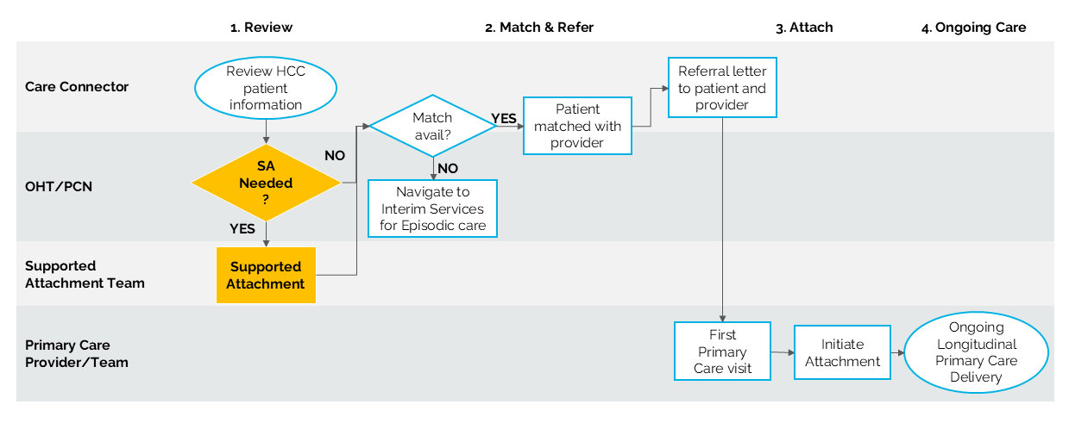
Supported Attachment – Sample Workflow A
Supported Attachment can occur at different points before attachment to a primary care clinician.
For example, Supported Attachment could occur before a patient is matched with a primary care clinician and the information gathered would inform the matching process. This model supports attachment by improving complexity distribution among local primary care clinicians and teams.
It is important to note that Supported Attachment does not replace comprehensive primary care. Patients remain unattached and should continue to access services available to unattached individuals, such as walk-in clinics or urgent care, for ongoing needs.

Slide 12
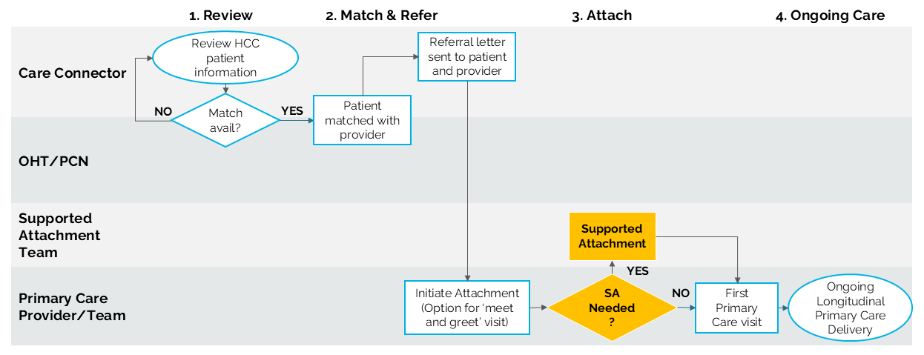
Supported Attachment – Sample Workflow B
Supported Attachment could also occur after a patient is matched with a primary care clinician (but before their first visit)
Supported Attachment after matching:
Helps to ensure patients are better prepared for their initial visit
Reduces administrative burden on primary care clinicians
Supports smoother attachment.

Slide 13
Funding to Support Implementation
The primary purpose of Supported Attachment funding is to support staffing to deliver services. Other eligible expenses to support implementation include:
Digital enablers such as developing form templates, enabling EMR interoperability, and acquiring software for data collection.
Legal costs for establishing data-sharing agreements among primary care practices are allowed.
Translation and interpretation services to promote equitable care delivery.
Start-up costs such as laptops, EMR licensing fees, and procuring necessary supplies.
Communications expenses, including printing consent forms and promotional materials amongst patients and providers.
OHTs should refer to the 2025/26 TPA Amendment for details on eligible and ineligible expenses.

Slide 14
Tracking Success
Effective data collection and monitoring supports accountability, informs ongoing quality improvement, and enables responsive service design. OHTs will be required to report bi-monthly on the following locally collected performance measures:
The number of patients who receive Supported Attachment services, including the number who were on the HCC waitlist.
The number of clinical and non-clinical resources (i.e., staff) hired for the purposes of implementing and advancing Supported Attachment.
The number of primary care clinicians and teams accessing Supported Attachment.
In addition to data reporting, as a requirement of the OHT TPA amendment, OHTs will be required to report on the following:
Supported Attachment Implementation Plan and Budget
Financial Reports and Progress/Year-End Reports
Reporting templates will be provided by Ontario Health.
Data will be analyzed at the provincial-level to inform program improvements. OHTs and PCNs should work together to establish processes and tools for accurate, timely, and well-documented data collection.

Slide 15
Implementation Support
Ontario Health Regional Points of Contact
  OH Central: Amy Khan
  OH East: Laurel Hoard
  OH Northeast: Lynne Kinuthia/Laura Boston
  OH Northwest: Kiirsti Stilla
  OH Toronto: Madeleine Morgenstern
  OH West: Jennifer Peckitt
Additional Key Contacts
Contact details in the Supported Attachment Guidance Appendix
Ontario Health Regional Digital Leads
Ontario Health Regional Equity Teams
OHT Central Program of Support Partners (including RISE PHM Coaches)

Slide 16
Overview of the 2025/26 OHT TPA Amendment
Fredrika Scarth, Vice President, Integrated Care​, Ontario Health

Slide 17
2025/26 OHT TPA Amendment
All OHT Updates
Funding to support implementation of Supported Attachment.
There is no longer a requirement to submit 25/26 cQIP Progress Reports in Navigator by March 31, 2026.
Requirement to track patients supported by Chronic Disease Prevention and Management (CDPM) models of care.
Updates for Select OHTs
Requirement to identify and report unique patients supported by CDPM models of care to OH. Initial 12 OHTs only.
Initial 12 OHTs and OHTs implementing Integrated Clinical Pathways (ICPs) are no longer required to identify a lead Health Information Custodian (HIC) to collect data on behalf of partner organizations. Multiple HSPs will directly collect and submit enrolment data to OH through a Data Sharing Portal.
Funding to support select Initial 12 OHTs to participate in an advisory capacity in the development of the provincial cyber security strategy for primary care.

Slide 18
Facilitated Q&A
Facilitator:
Meaghan Cunningham, Director, OHT Implementation, Ontario Health
Panelists:
Allison Costello, Director, OHT Policy and Operations Branch, Ministry of Health
Fredrika Scarth, Vice President, Integrated Care, Ontario Health
Dr. Brian McKenna, Regional Primary Care Clinical Lead, Ontario Health
Aruna Mitra, Director, Patient Services, Ontario Health atHome

Slide 19
Questions
    Questions can be submitted through the Q&A box:
    Due to limited time, unanswered questions should be advanced Ontario Health Regional Points of Contact.

Slide 20
Next Steps & Closing Remarks
Fredrika Scarth, Vice President, Integrated Care​, Ontario Health

Slide 21
Next Steps & Closing Remarks
The Supported Attachment Guidance will be sent to OHTs and PCNs via OH Regions in the coming days.
A recording of today's webinar and the slide presentation will soon be made available.
Questions continue to be welcomed to the ontariohealthteams@ontariohealth.ca mailbox and please copy your OH regional point of contact.
Thank you for participating in today’s webinar

