Slide 1



TOOL
Youth Wellness Journey Canvases

Slide 2


NOTES FOR ONTARIO HEALTH TEAMS
Many Ontario Health Teams (OHTs) are focusing on integrating care for people with mental health challenges in Year 1. Youth are a sub-population that experience additional barriers and challenges to accessing services to improve their mental health and wellbeing. The Youth Journey Canvas Tool can help OHTs consider the nuances and complexities of this population when planning and designing services.
When building your application, consider with your team…
What does the journey of youth look like as they seek help for their mental health and wellness? How might this vary in our local context?
What are the barriers and challenges each youth experience as a result of our current health care system and local resources?
How could each individuals’ needs be better met with an improved, more integrated, or newly designed program/service?
When you’re ready to tackle the specifics of your plan, consider with your team…
How can we ensure our service is accessible and safe to all youth?
How can we make our service interesting and engaging? Which of these individuals would be most or least likely to use/benefit from this service?
Do our plans to integrate care promote social inclusion and mental wellness for each individual?
Relevant for Teams in:
Application Stages
Year 1 Implementation
Priority Population:
Youth
Mental health
Connecting to RISE:
Building Block 4: Patient care and experience

Slide 3

IN A NUTSHELL
An increasing number of youth are experiencing mental health challenges in Ontario. We know that youth face unique obstacles and barriers to maintain wellness and seek help. Understanding how youth experience the health care system and the journey they take can help us to better design services that meet their needs.
What does this tool help you do?
This tool helps ground discussions in the experiences of youth as they navigate (with varying levels of ease & success) through the health and social service system. Using this tool will keep the client/patient perspective in mind at all times and ensure an empathetic approach to the diversity of barriers, challenges, and stigma that youth may face.

Slide 4


ABOUT THIS TOOL
What was the tool developed for?
The youth journey canvases walk readers through the journey of three fictional personas of youth with mental health issues and illustrate their experience with the mental health system. The canvases were created as part of a workshop with an Ontario Health Team to map community mental health and wellness resources. They ground the workshop conversations in the rich stories of individuals and allow participants to speak openly about experiences in the mental health system without having to disclose personal information.
How did we use it?
Youth and providers read the journey canvases aloud. At each phase of the youth’s journey, participants thought about what resources in the community may be helpful for the individual. This also prompted discussion about what resources are not available and how existing services or programs could be modified to better meet the needs of the individual.

Slide 5



HOW YOU
CAN USE
THIS TOOL
Print them out and use them as part of a workshop or a meeting.
Use the editable template to make your own canvases with your client/patient stories.
Experiment with the canvases! Imagine how Jennifer, Don and Ivy would experience your service or respond to your engagement strategy.

Slide 6
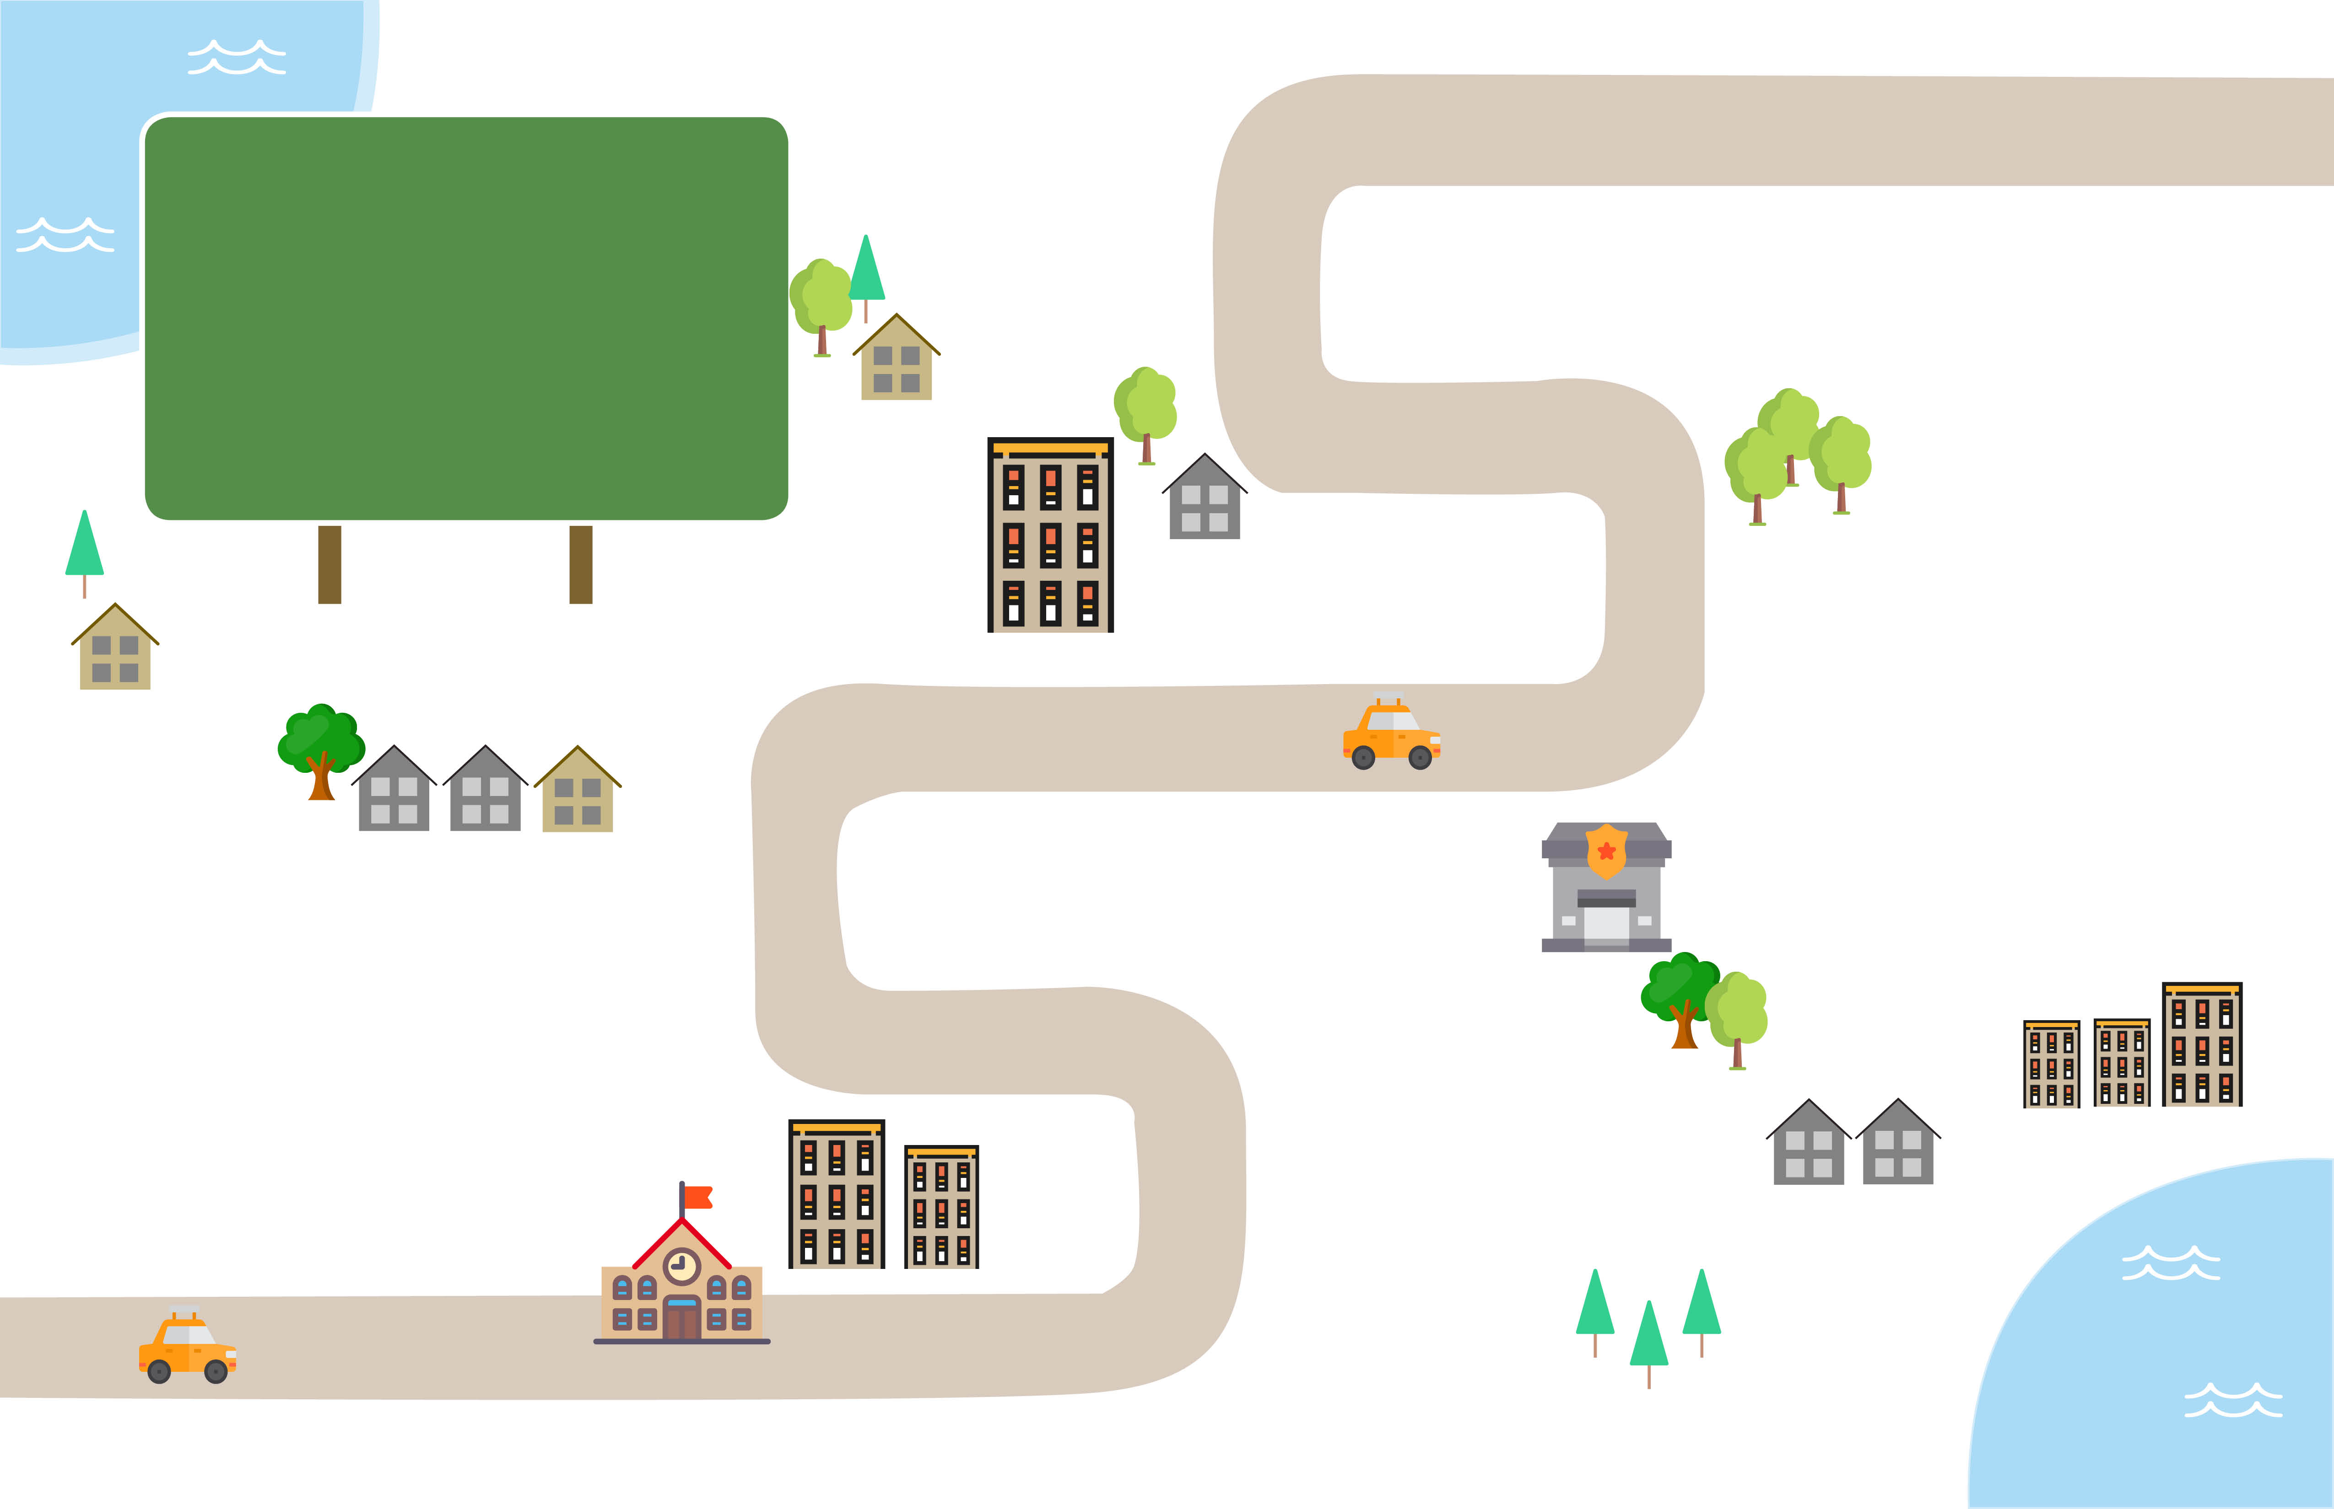
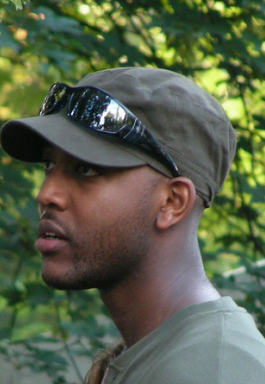
Navigating
the System
Taking Care
7.
Don's Story
Gender: Male
Age: 17
Citizenship: Canadian Born
Ethnicity: Black
Gender Identity: Cis gender
6.
Jennifer and her parents struggled to find professional support that could address her mental illness, but also understand the unique issues she faced as a LGBTQ youth.
By receiving care in a space around people with similar lived experience who are also dealing with mental illness, Don felt like he wasn’t alone. Don started to see a noticeable difference in his mood, but still works with his counsellor on follow-ups to work through the highs and lows that life throws at him.
Difficult
Times
Seeking Help
Diagnosis
4.
3.
Don’s grades started to drop, and his mother saw a noticeable difference in his behavior.
Don’s mom reached out to their family doctor for help.
5.
Don was diagnosed with mild depression and anxiety with a recommendation to seek counselling to help him cope with his mood disorder.
Awareness
Uncertainty
1.
Don grew up with his single mom who often had to work double jobs to keep the family afloat. During his first year of high school, Don began struggling with feelings of sadness, loneliness, and anxiety.
2.
Don did not want to upset his mom, who was often overwhelmed with work. Instead of discussing his mental health concerns with her, he kept them to himself.

Slide 7
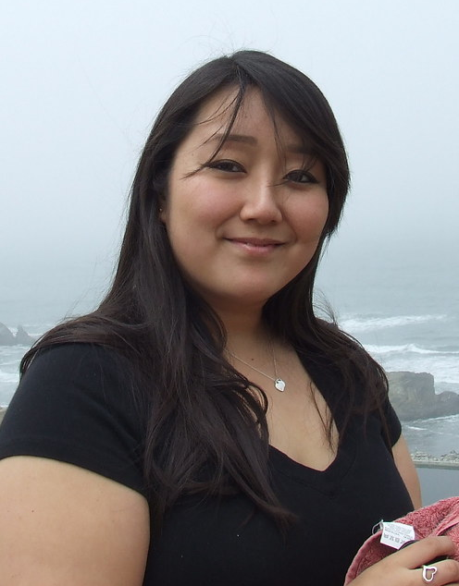
Navigating
the System
Ivy tried various forms of recommended treatment, including medication and counselling, but nothing worked for her. It was very hard to find mental health services that address both her condition, as well as her challenges as a newcomer to Canada.
Ivy's Story
Gender: Female
Age: 17
Citizenship: Newcomer
Ethnicity: Asian
Gender Identity: Cis gender
Taking Care
6.
5.
Ivy was eventually put in touch with Hong Fook Youth Outreach, where she was able to find the right treatment in an environment where she felt comfortable.
Difficult
Times
Diagnosis
3.
After missing weeks of school due to suicidal thoughts, Ivy was confronted by a school counsellor who directed to a social worker.
4.
Ivy was diagnosed by a medical professional as having severe depression, requiring both pharmaceutical and therapeutic interventions.
Awareness
Seeking
Help
1.
At 17, Ivy, a newcomer to Canada, lost her father. Feeling lost, frustrated, and struggling to learn English, she felt feelings of sadness and anxiety.
2.
Ivy found it challenging to discuss her problems with friends and family. She resorted to skipping school, and spending more time alone.

Slide 8

Navigating
the System
Jennifer's Story
Gender: Female
Age: 18
Citizenship: Canadian Born
Ethnicity: White
Sexual Orientation: LGBTQ
Jennifer and her parents struggled to find professional support that could address her mental illness, but also understand the unique issues she faced as a LGBTQ youth.
Taking Care
6.
5.
After finding the East QREW Group; a community organization supporting LGBTQ youth, she found a safe space to address her mental health and identity.
Difficult
Times
Diagnosis
3.
Jennifer started experimenting with drugs and alcohol to deal with her depression, while she continued looking for LGBTQ-specific support
4.
Jennifer’s parents, concerned about her drug and alcohol use, took her to see a doctor where she was diagnosed with depression and anxiety.
Awareness
Seeking
Help
1.
Jennifer struggled with feelings of sadness, loneliness, and anxiety in social settings. She also experienced bullying from classmates.
2.
Due to lack of support in her school and from her family, Jennifer tried reaching out on social media to find support to join LGBTQ online groups.

