Slide 1




Four events in 2024 culminated in a breakthrough, namely an intention to fund an
‘Evidence Synthesis Infrastructure Collaborative’ (or ESIC)
What Works Climate Solutions Summit in Berlin, where bold thinking about the need for large-scale, AI-enabled suites of living evidence syntheses began to emerge
‘SHOW ME’ the evidence consensus posted, which helped key ‘interest holders’ to jointly describe a better future and reassured funders that there was a ‘money problem’ and not a ‘people problem’
Global Evidence Summit in Prague, where leaders from Campbell, Cochrane and JBI committed to working with a broad coalition of partners to design and help execute a step-change improvement
Summit of the Future in New York, where a breakthrough announcement was made, which triggered the Evidence Synthesis Infrastructure Collaborative (ESIC) planning process that is now underway
Jun
9-12
Sep
4
Sep
10-13
Sep
23-24
‘SHOW ME the evidence’ consensus posted

Slide 2
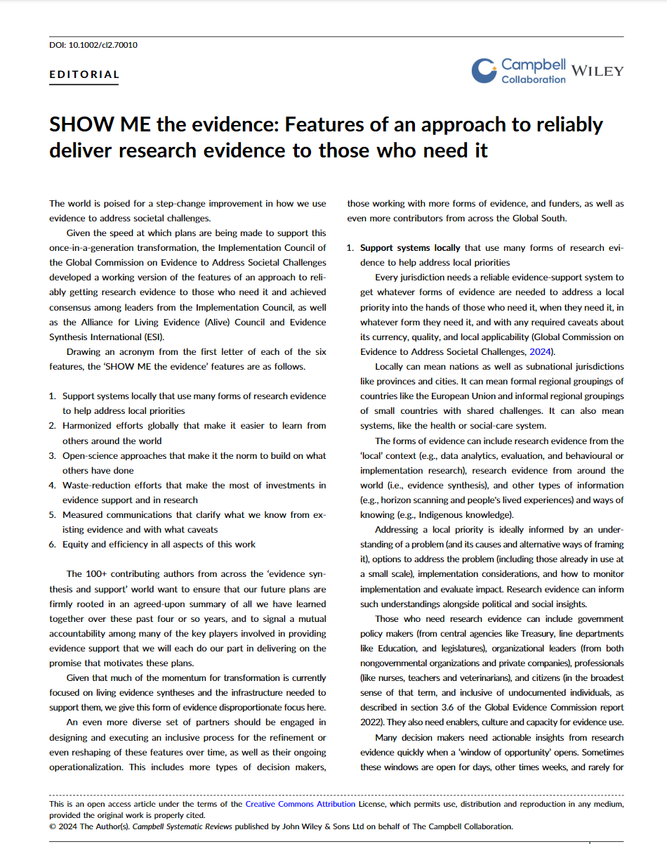
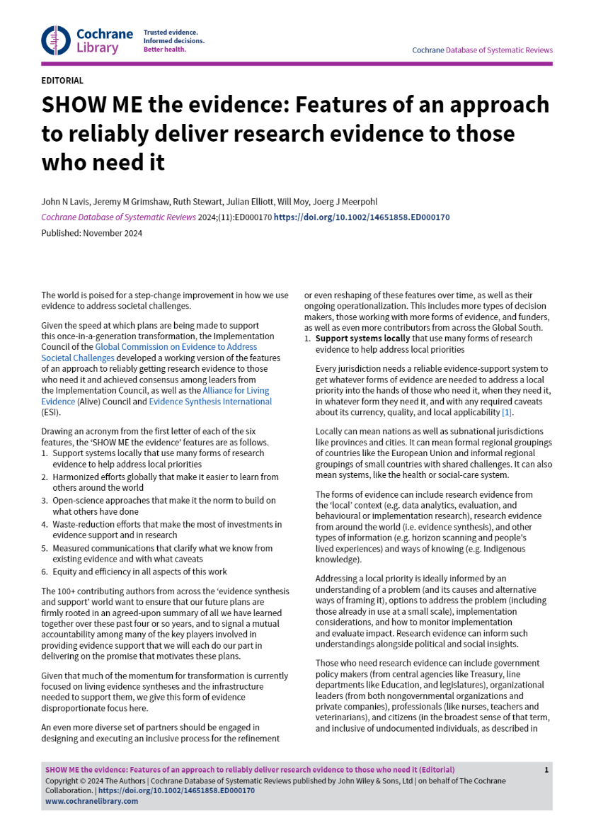
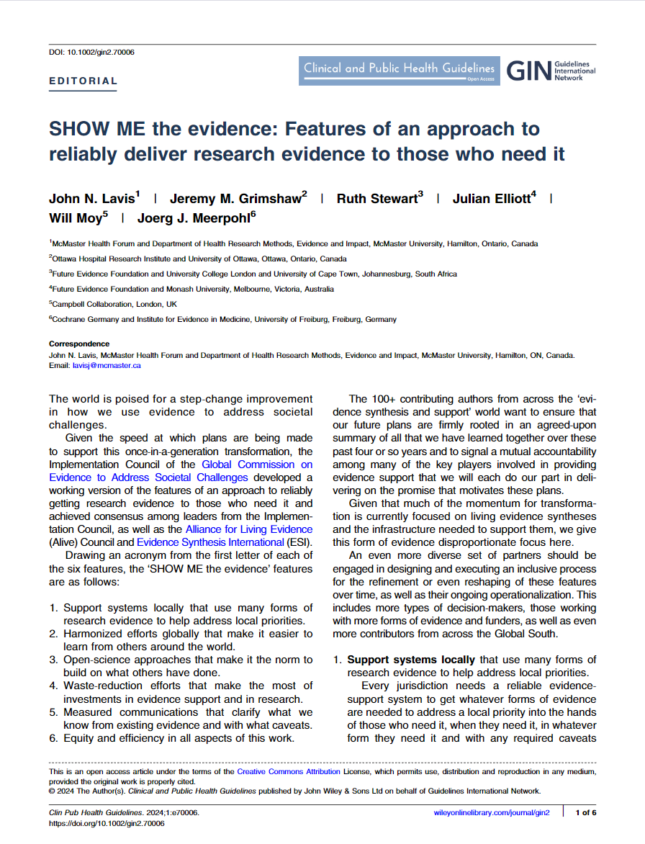
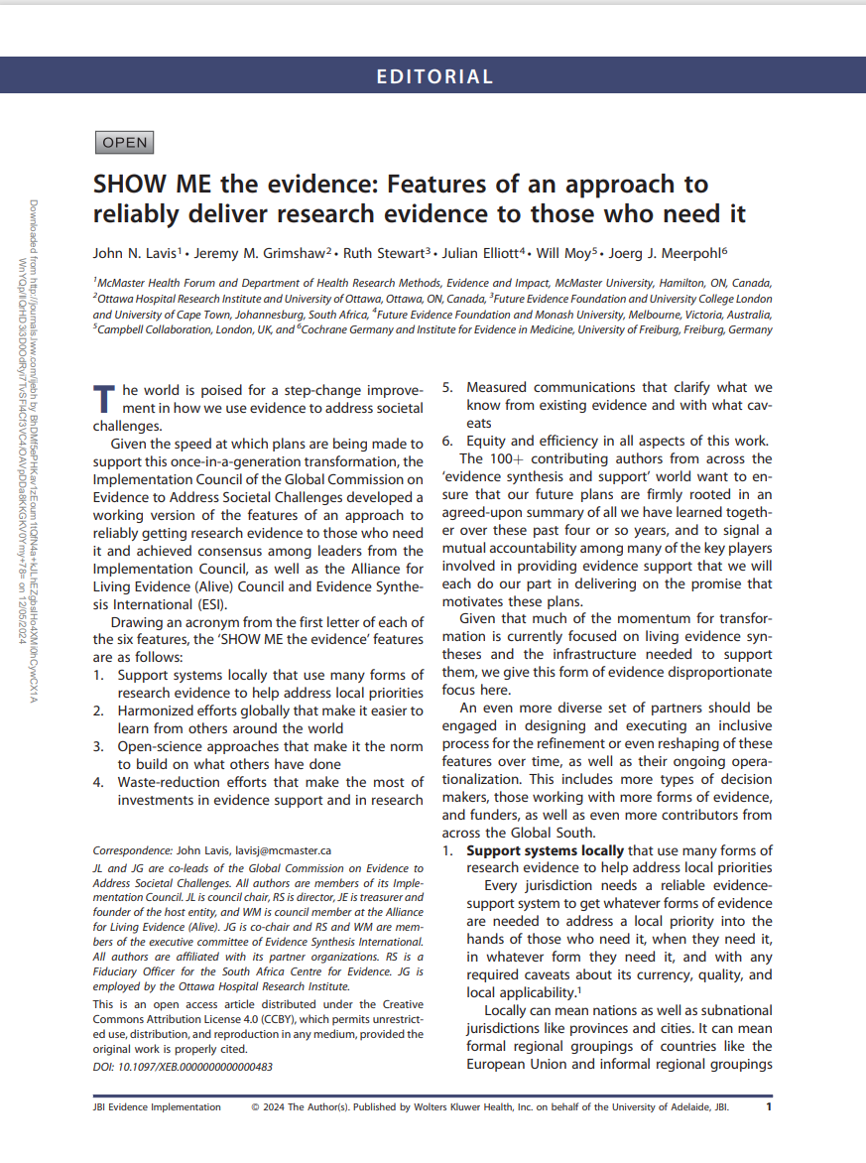
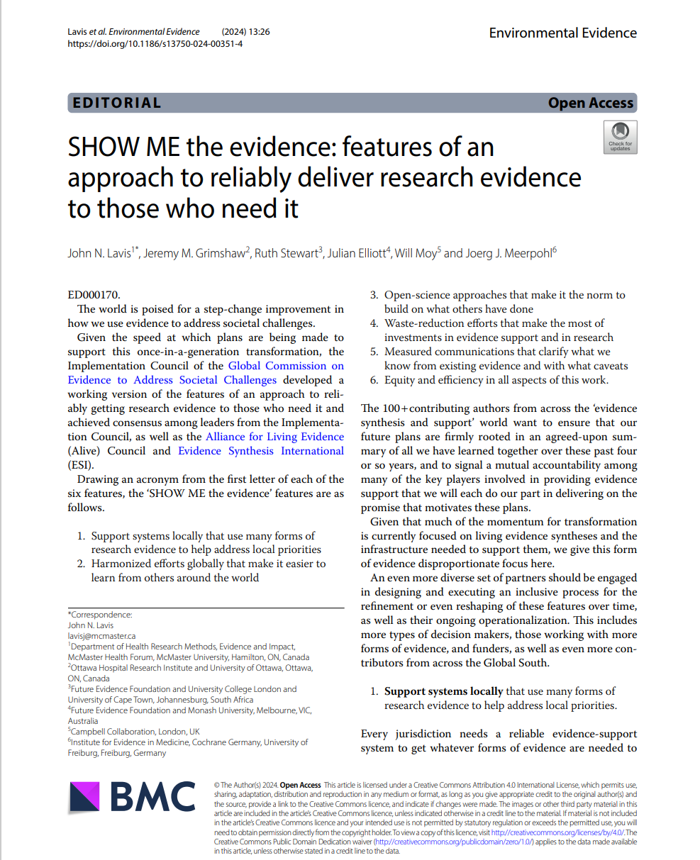
A consensus statement helped to consolidate the case for change
SHOW ME the evidence: Features of an approach to reliably deliver research evidence to those who need it
Support systems nationally (and locally) that use many forms of research evidence to help address local priorities
Harmonized efforts globally that make it easier to learn from others around the world
Open-science approaches that make it the norm to build on what others have done
Waste-reduction efforts that make the most of investments in evidence support and in research
Measured communications that clarify what we know from existing evidence and with what caveats
Equity and efficiency in all aspects of this work
Available in seven languages (Arabic, Chinese, English, French, Japanese, Portuguese, Spanish)
Co-published in five journals (Campbell Collaboration, Cochrane, Collaboration for Environmental Evidence, Guidelines International Network, JBI)

Slide 3
Additional reports, journal reporting, complementary announcements and statements were all part of a flurry of activity leading up to and following up on the ESIC announcement
Date | Title | Description
4 Sept 2024 | ‘SHOW ME the evidence’ consensus (working version posted on the Global Evidence Commission website) | Features of an approach to reliably deliver research evidence to those who need it.
9 Sept 2024 | A blueprint for better international collaboration on evidence | NESTA/ U.K. Behavioural Insights Team report (informally the ‘Four country commission’ report) on how countries can collaborate on evidence synthesis and on evaluation
17 Sept 2024 | Unearthing ‘hidden’ science would help to tackle the world’s biggest problems | Nature editorial about the Global SDG Synthesis Coalition by Helen Pearson (an editor at Nature)
19 Sept 2024 | Transforming global evidence: AI driven evidence-synthesis for policymaking | Open funding call for £11.5 million (US$15 million) by U.K. Research and Innovation (UKRI) for an infrastructure that will support demand-side engagement and integrate human and AI capabilities to deliver a 'demonstrator case' for radically more relevant, timely and affordable living evidence syntheses
21 Sept 2024 | ’Intent to fund’ announcement: Evidence Synthesis Infrastructure Collaborative | Announcement that the Wellcome Trust will provide £45 million (US$60 million) in funding over five years for an ‘Evidence Synthesis Infrastructure Collaborative’ that will support demand-side engagement and the safe and responsible use of AI, as well as data sharing and reusing, methods and process innovation, and capacity sharing
21 Sept 2024 | Towards 2030 and beyond: Accelerating the SDGs through access to evidence on what works | Video recording of panel-led discussion about the role of science and digital technologies in accelerating progress towards the SDGs, which includes Wellcome Trust CEO, John-Arne Røttingen, formally announcing the Wellcome Trust investment
21 Sept 2024 | Scientists are building giant ‘evidence banks’ to create policies that actually work | Nature article about the two funding announcements by Helen Pearson
21 Sept 2024 | US $74 million new investments in SDG evidence to be announced | Statement from Global SDG Synthesis Coalition about the two funding announcements
22 Sept 2024 | X thread about the transforming global evidence funding announcement | X thread about the UKRI investment by Executive Chair of the U.K.’s Economic and Social Research Council, Stian Westlake
2 Oct 2024 | ‘Evidence banks’ can drive better decisions in public life | News article from the Financial Times about the two funding announcements

Slide 4
ESIC planning process is adopting a collective-impact approach, starting with agreement on a common agenda for the needed infrastructure
Examples in the education sector:
Best buys: GEEAP
Broad approaches: EEF
Branded programs: IES WWC
Actionable insights served up in different ways for different decision-makers, sectors, regions & languages
[future investments by other funders]
Living evidence syntheses (LESs)
about accelerating progress towards the SDGs
[UKRI investment of £11.5M, which will also target infrastructure elements 1 & 3]
Suites of LESs on additional SDG priorities
[current & future Wellcome Trust (WT) investments in its 3 solution areas]
Suites of LESs on additional SDG & other priorities
[future investments by other funders]
Infrastructure [WT investment of £45M] 1) Demand-side engagement; 2) Platforms for data sharing and reusing; 3) Safe & responsible use of AI [WT investment of £10M in AI];
4) Methods and process innovation; 5) Capacity sharing

Slide 5



ESIC planning process will engage many categories of ‘interest holders,’ particularly now those captured in the two circles on the left and the two circles on the right
Four-country commission & similar groups National (and local) governments
(including bilateral development funders)
Support systems nationally (and locally) that use many forms of research evidence to help address local priorities
Global SDG Synthesis Coalition UN agencies & offices (and multilateral banks, international financing partnerships & scientific advisory boards)
Knowledge broker & science advisor networks Evidence intermediaries
(e.g., AEN & HubLAC; INGSA & RFICS)
Advisory and decision-making processes
(e.g., involving government policymakers and organizational leaders)
Learning and improvement platforms
(e.g., supporting professionals)
Citizen & community engagement initiatives
Building a Global Evidence-Synthesis
Community (BGESC) Evidence-synthesis groups
Council of Boundary
Spanners (CoBS) Groups leading on other forms of evidence (e.g., data analytics, evaluation, behavioural
science)
Funders Interest Group Research funders (both evidence synthesis & primary research)
and other types of funders
Tech companies that may contribute technology or use the data

Slide 6
ESIC planning process is being led by five working groups and a governance planning group, each of which will prepare five documents for which they will be seeking feedback
Working groups (WGs) and planning groups (PGs) | Focus
WG1: Demand-side engagement | Get producers and potential users working together to understand and meet user needs
WG2: Data sharing and reusing | Make it normal to study a question once and use the answers many times in many different contexts
WG3: Safe and responsible use of AI | Bring evidence synthesis to the forefront of technology so that we can get the best impact from the people and resources we have
WG4: Methods & process innovation | Devise synthesis methods and processes that enable radically more timely, relevant, and affordable synthesis
WG5: Capacity sharing | Build a global community with the capabilities to deliver and use evidence synthesis across all major societal questions
PG1: Governance | Devise options for how key interest holders can continue to set and achieve shared goals beyond this process
Additional PGs to be activated later
Draft documents | Consultation window opens
1) Capability profile for each focus area | February 12
2) Capability-maturity assessment and gap map for each focus area | March 12
3) Strategies for strengthening capabilities related to each focus area, including any ‘quick wins’ with ‘no regrets’ | April 30
4) Impact effort matrix and conclusions/recommendations for each focus area | May 21
5) Report – now incorporating costing and additional planning-group considerations – for each focus area that will be pre-circulated to consensus meeting attendees | June 4

