Slide 1
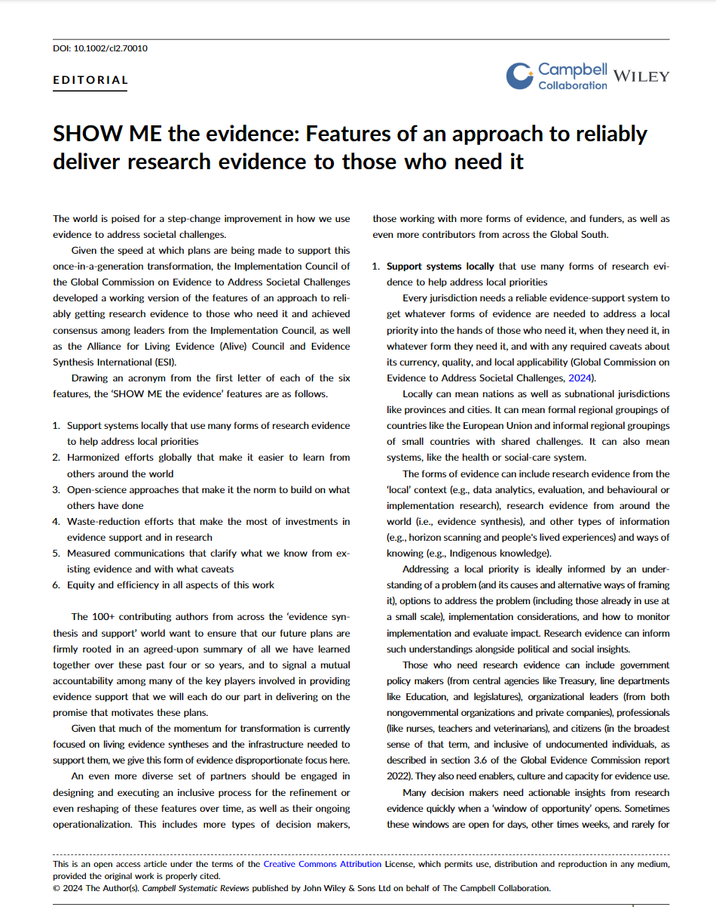
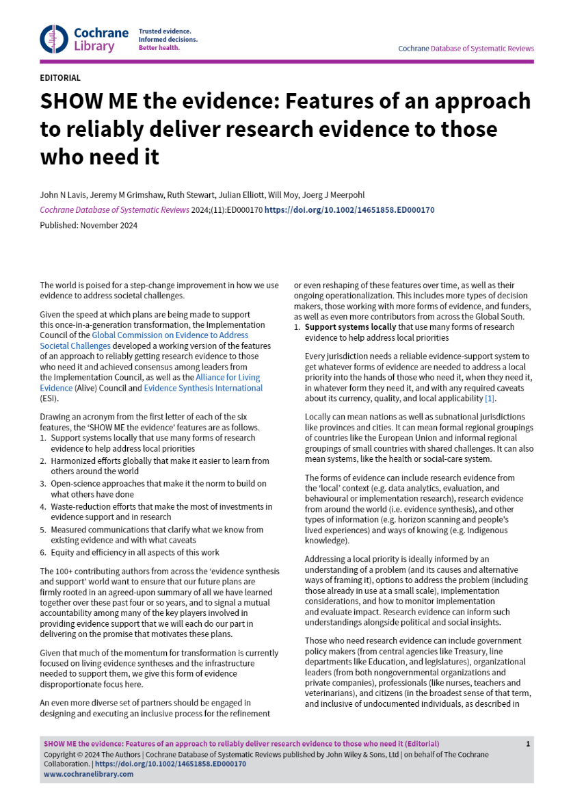
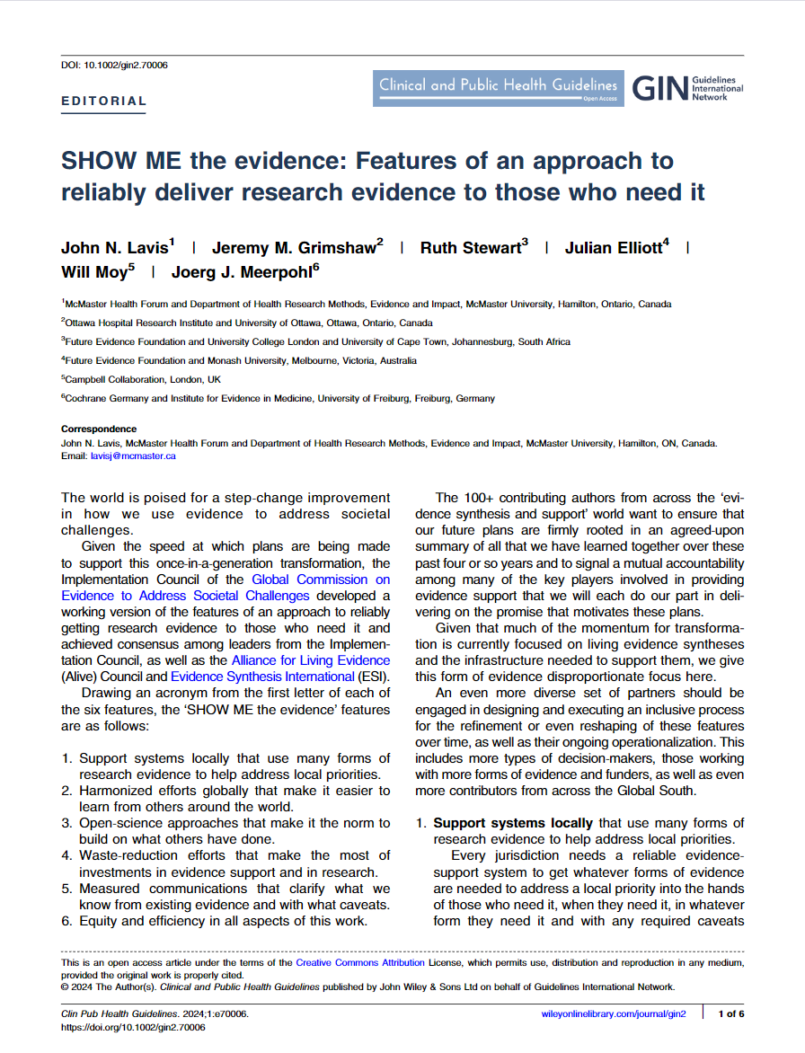
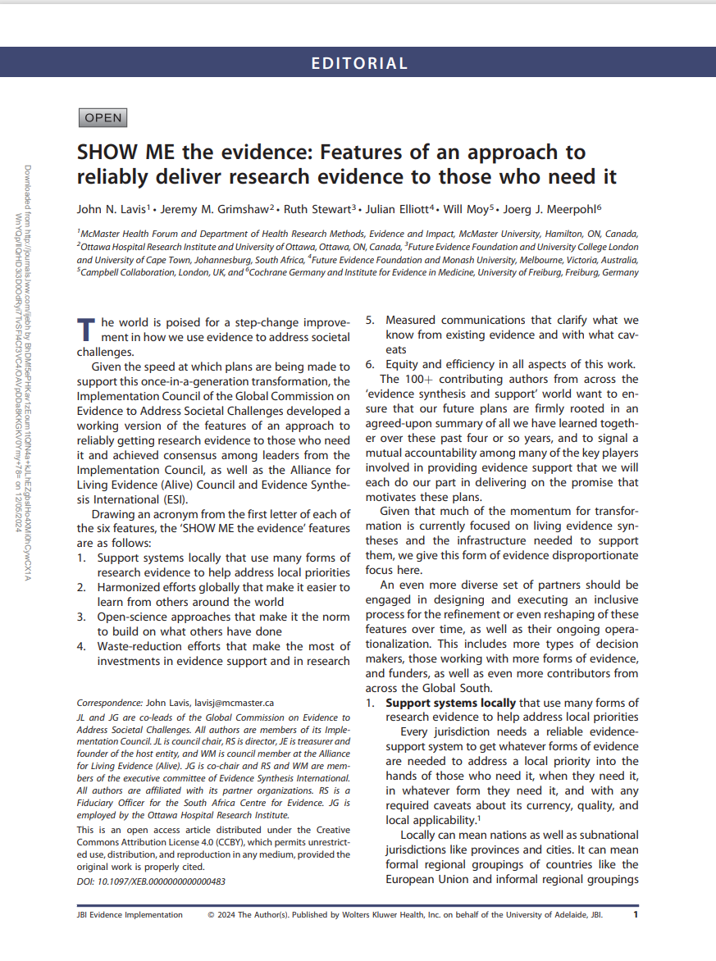
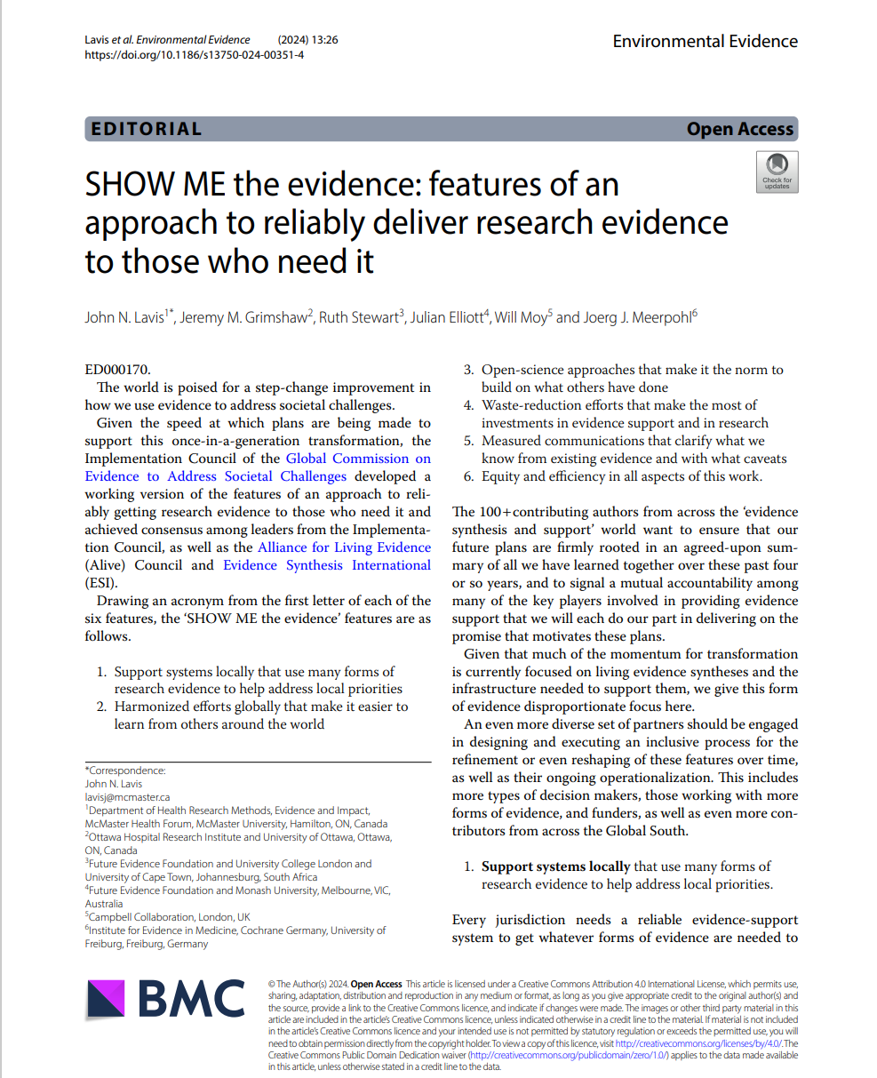
A consensus statement helped to consolidate the case for change
SHOW ME the evidence: Features of an approach to reliably deliver research evidence to those who need it
Support systems nationally (and locally) that use many
forms of research evidence to help address local priorities
Harmonized efforts globally that make it easier to learn from others around the world
Open-science approaches that make it the norm to build on what others have done
Waste-reduction efforts that make the most of investments in evidence support and in research
Measured communications that clarify what we know
from existing evidence and with what caveats
Equity and efficiency in all aspects of this work
Available in seven languages (Arabic, Chinese, English, French, Japanese, Portuguese, Spanish)
Co-published in five journals (Campbell Collaboration, Cochrane, Collaboration for Environmental Evidence, Guidelines International Network, JBI)

