Slide 1






Momentum is building for a step-change improvement in each implementation priority, and more generally in how we use evidence to address societal challenges
Update 2024
Report
Update 2023
*
    Formalize and strengthen domestic
    evidence-support systems
    Enhance and leverage the global
    evidence architecture
    Put evidence at the centre of
    everyday life

Slide 2
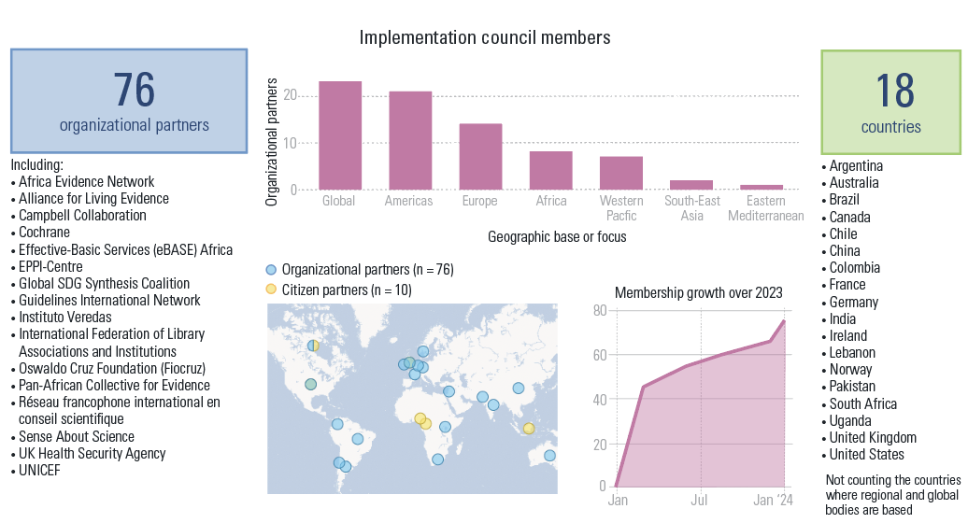
Our Implementation Council is now 76 organizational partners strong, and drawn from 18 countries in every part of the world and from many global and regional bodies

