Slide 1
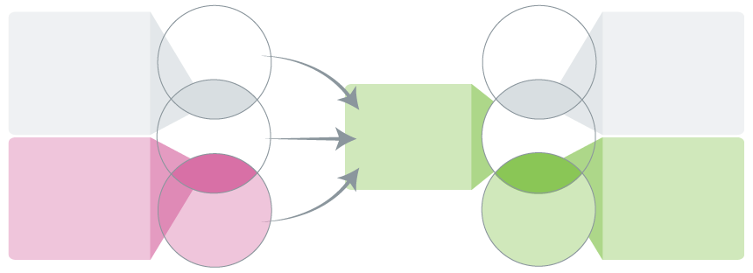
2.0 Improving coordination among evidence producers
(both global and domestic) is an important place to start
Note: full version available in Update 2023
Global level
Domestic level
Global hybrid decision-makers and intermediaries
(e.g., global commissions and technical units within the global, regional and country offices of multilateral organizations that support member states)
Normative
guidance
Local hybrid
decision-makers and intermediaries
(e.g., domestic commissions, government advisory bodies, government science advice, and government evidence support)
Decision-makers
Decision-makers
Hybrid
Hybrid
Technical
assistance
Intermediaries
Domestic evidence-support networks
Intermediaries
Global hybrid
evidence intermediaries and producers
(e.g., Cochrane and Intergovernmental Panel on Climate Change (IPCC) working groups)
Local hybrid
evidence intermediaries
and producers
(e.g., local evidence-support units focused on
specific forms of evidence, sectors, etc.)
Hybrid
Hybrid
Producers
Producers
Evidence-related global public goods, especially living evidence syntheses
© 2023 McMaster University. All rights reserved. This work is licensed under a Creative Commons Attribution-NonCommercial-ShareAlike 4.0 International License.

