Slide 1
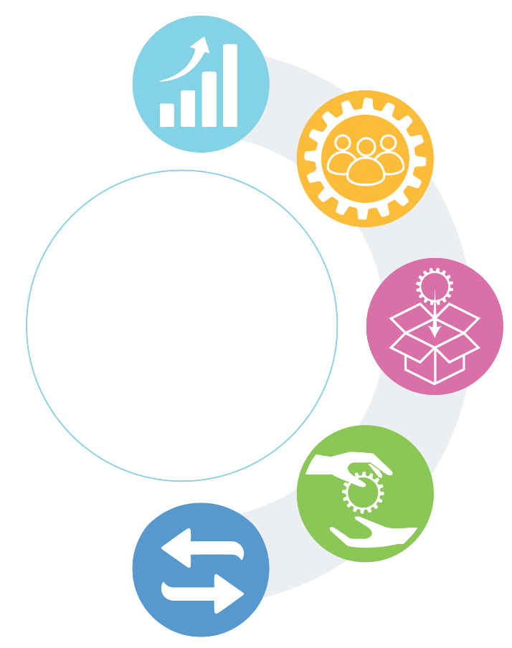
5.3 Strategies used by evidence intermediaries
Strategies | Descriptions
 | Sharing examples of outcomes and impacts achieved using best evidence and of missed opportunities from failing to use best evidence Demonstrating how to distinguish high from low quality evidence (see section 4.5), how to distinguish best evidence from ‘other things’ (section 4.8), and how to get more out of ‘other things’ (section 4.8) ‘Auditing’ decision-making and advisory structures, processes and outputs, as well as the incentives influence them, to identify opportunities to systematize evidence use Comparing a local (national or sub-national) evidence-support system to a high-functioning evidence-support system, or comparing a local evidence-implementation system to a high-functioning evidence-implementation system, using prompts like this list of strategies that evidence intermediaries can use
 | Engaging in listening (e.g., rapid response) and foresight activities (e.g., horizon scanning) to identify emerging issues, make sense of them, prioritize those requiring evidence support, and commissioning or undertaking the evidence support Co-producing – with decision-makers – new local (national or sub-national) evidence specific to the jurisdiction of focus (data analytics, modeling, evaluations, behavioural / implementation research, qualitative insights), synthesizing the best evidence globally (evidence synthesis), and translating global and local evidence into local decision support specific to the jurisdiction (technology assessments and guidelines, as well as modeling if it is undertaken with this intent) Co-developing and maintaining living evidence products (data analytics, modeling, evidence syntheses, and guidelines)
 | Packaging evidence in ways that make it understandable to decision-makers (and communicating or disseminating it to those who can use it) • e.g., making data analytics more understandable using data-visualization approaches (e.g., bar/pie chart, box-and-whisker plots, scatter plots, and networks) • e.g., making evidence syntheses more understandable using plain-language summaries translated into multiple languages Using evidence to combat mis- and dis-information online, in fact-checking, and in other efforts to counter claims not based on evidence Integrating different forms of evidence into innovative types of evidence products (e.g., data analytics to clarify a problem and its causes, evidence synthesis to describe the likely benefits and harms of an option to address a problem, and behavioural science to develop an implementation plan) Identifying whether professionals and citizens are already engaged in key evidence-implementation processes described in section 4.14 • e.g., are they behaving in ways consistent with evidence-based recommendations? • e.g., if not, are they assessing their capacity, opportunity and motivation to do so? • e.g., are they designing implementation strategies based on what is learned in this assessment? • e.g., are they implementing and evaluating the strategies, and incorporating lessons learned in the next cycle? Embedding evidence in decision-support tools that decision-makers are already using (e.g., briefing notes for government policymakers; dashboards for organizational leaders; and decision-support systems used by professionals like physicians, which are increasingly powered by artificial intelligence) or in decision-related documents that decision-makers could use (e.g., model legislation)
 | Maintaining one-stop evidence shops that are optimized for decision-makers’ needs (e.g., Education Endowment Foundation [UK] and What Works Clearinghouse [US] for educators; Evidence Aid for humanitarian-aid providers) Maintaining a rapid-evidence service that can respond with best available evidence to decision-maker requests for evidence on short timelines (e.g., one-to-30 business days Building capacity among decision-makers to acquire, assess, adapt and apply evidence
 | Convening deliberative dialogues to work through – based on both best evidence and all of the other factors that may influence decision-making – a problem and its causes, options to address it, key implementation considerations, and next steps for different constituencies (e.g., stakeholder dialogues and citizen panels that are informed by pre-circulated evidence briefs and citizen briefs)
Improving the climate for evidence use
Prioritizing and co-producing evidence
Five types of
strategies evidence
intermediaries can use
to support the use of
best evidence
Packaging evidence for, and ‘pushing’ it to, decision-makers
Facilitating ‘pull’ by decision-makers
Exchanging with decision-makers
1

