Slide 1


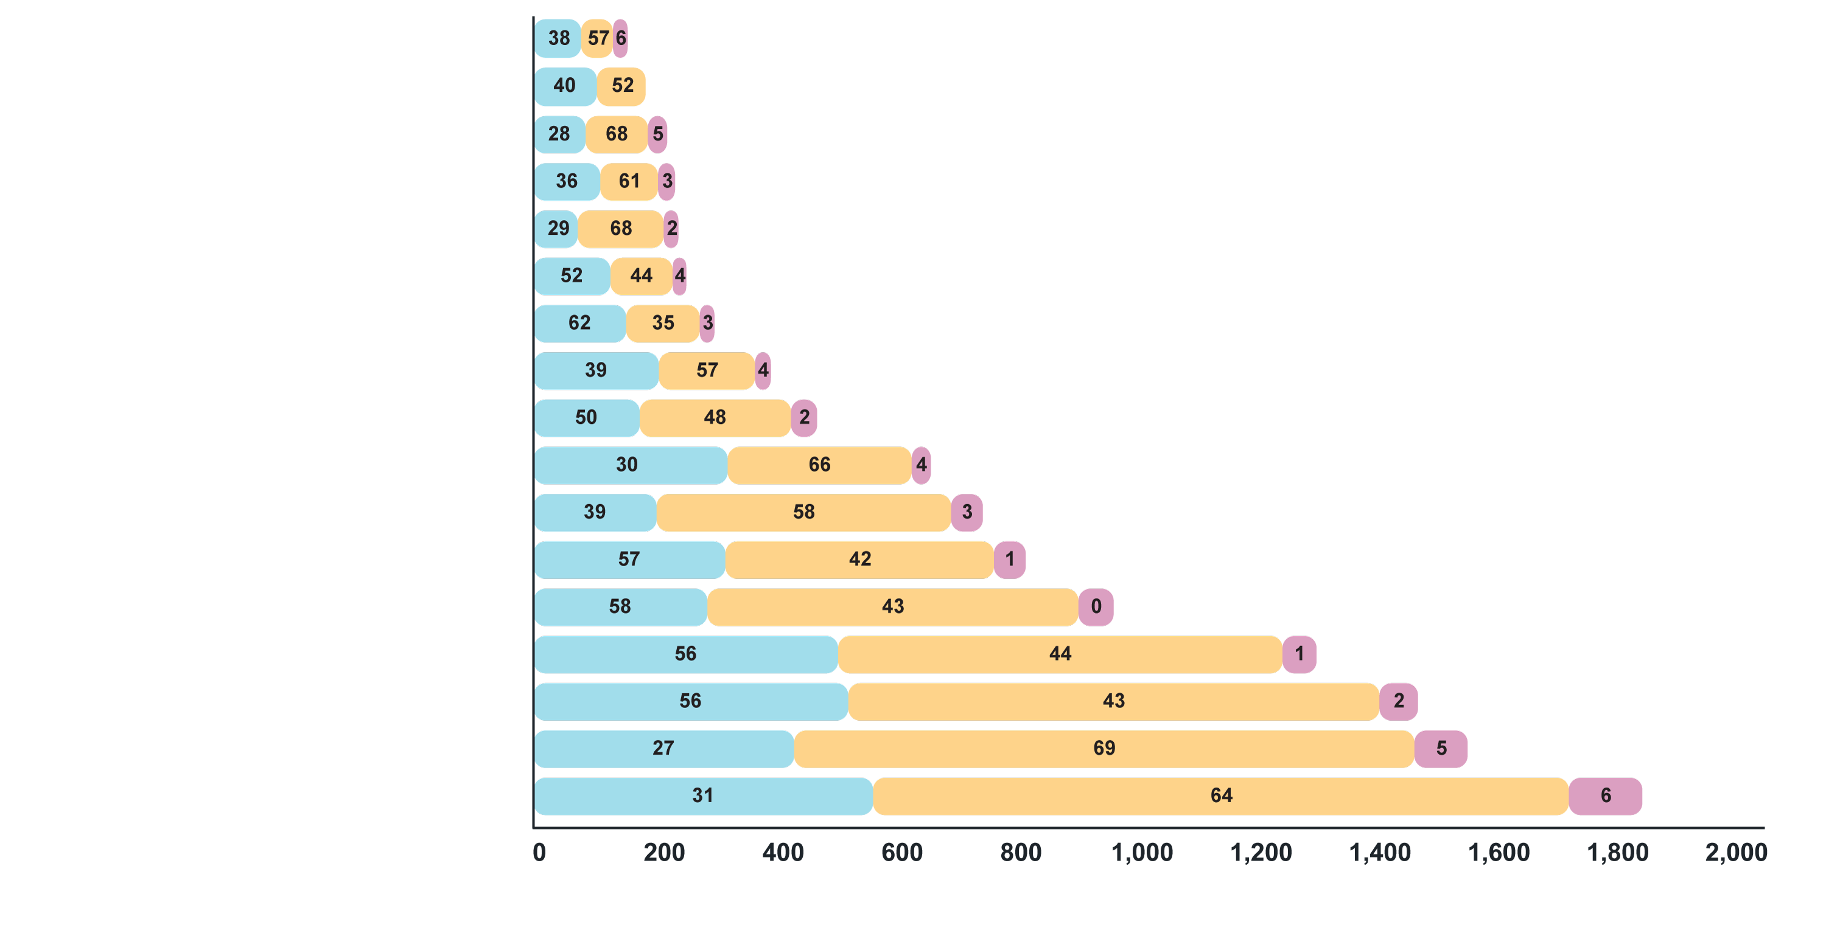
LEGEND
% low quality
% medium quality
% high quality
4.6 Coverage, quality and recency of evidence syntheses (1 of 2)
Of the 4,131 SDG-related evidence syntheses included in Social Systems Evidence as of 12 August 2021:
coverage was uneven, with seven SDGs addressed by only 263 syntheses
quality was uneven, with seven SDGs addressed by a stock of evidence synthesis in which at least half are of low quality
all SDGs have a median year of last search that is five or six years ago (2016 or 2017)
only between one in 10 and one in 20 evidence synthesis about most SDGs included at least one study from a low- and middle-income country
Note that the count for SDG 17 is likely an overcount and the count for SDG 3 is a significant undercount
7. Affordable and clean energy
13. Climate action
2. Zero hunger
6. Clean water and sanitation
5. Gender equality
14. Life below water
15. Life on land
12. Responsible consumption and production
1. No poverty
9. Industry, innovation and infrastructure
16. Peace, justice and strong institutions
8. Decent work and economic growth
10. Reduced inequalities
11. Sustainable cities and communities
4. Quality education
3. Good health and well-being*
17. Partnerships for the goals
Number of syntheses
1

Slide 2
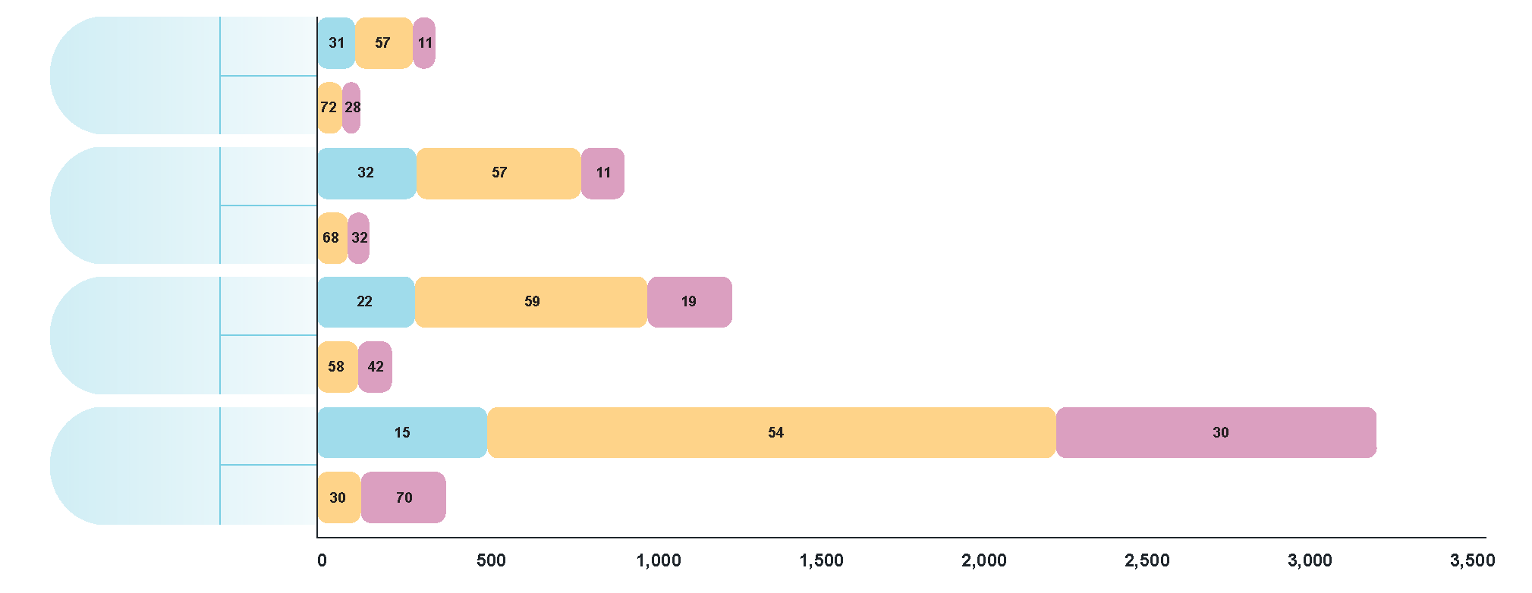
LEGEND
% low quality
% medium quality
% high quality
4.6 Coverage, quality and recency of evidence syntheses (2 of 2)
Of the 4,256 and 562 COVID-19-related evidence syntheses included in the full COVID-19 database and the COVID-END inventory of best evidence syntheses, respectively, as of 1 August 2021:
coverage was uneven, with only 237 evidence syntheses addressing economic and social responses to COVID-19
quality was uneven, with roughly one quarter of COVID-19 evidence synthesis being low quality and over half medium quality
three of the four COVID-19 response categories have a median date of last search that is within 4.5 months of WHO declaring a pandemic
Note that the much more recent median search date for clinical management – 12 months after the pandemic declaration and 4.5 months before the analysis was completed – was driven by the large number of drug-treatment comparisons from a single source
Economic
and social responses
Database
Inventory
Health-
system arrangements
Database
Inventory
Public-
health measures
Database
Inventory
Clinical management
Database
Inventory
Number of syntheses
2

