Slide 1
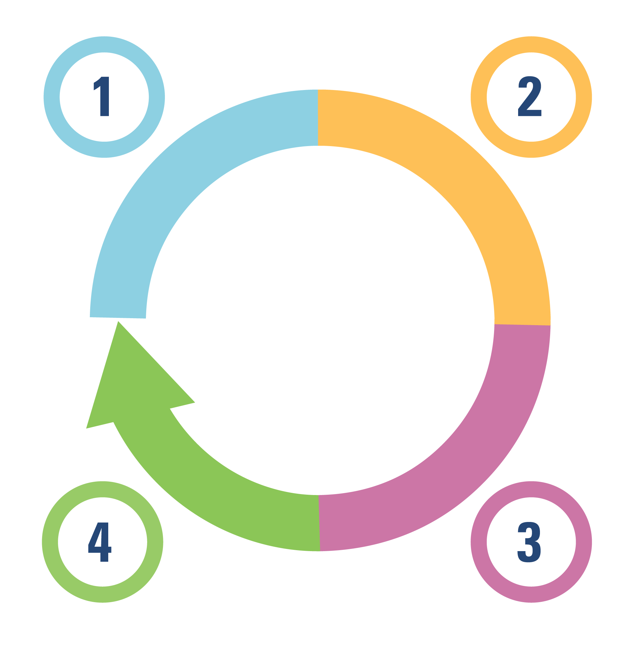




DRAFT FOR CONSULTATION – Last updated on 9 November 2021
3.1 Steps in deciding whether and how to take action
Understanding
a problem and
its causes
Selecting an option
for addressing
the problem
Steps | Related questions | Decision for a government policymaker | Decision for a citizen or community leader
 | How big is the problem? | Should we pay attention to this problem given all the others we face as a government? | Should I pay attention to this problem given all the others that the people and community I care about face?
 | Is the problem getting worse or is it bigger here than elsewhere?
 | How do different people describe or experience the problem and its causes?
 | What good might come of it? | Should we take any action to address this problem and, if yes, which option should we select? | Should I take any action to address this problem and, if yes, what action (e.g., talk to others about changing their behaviour, work with fellow community members on local solutions, or contact elected officials)?
 | What could go wrong?
 | Does one option achieve more for the same investment?
 | Can we adapt something that worked elsewhere while still getting the benefits?
 | Which groups support which option?
 | What will get in the way or help us in reaching and achieving desired impacts among the right people? | Should we take any additional steps to increase the chance that the selected option does what we intend it to do? | Should I work with fellow community members and encourage elected officials to take steps to ensure the selected option reaches the people and community I care about?
 | What strategies should we use to reach and achieve desired impacts among the right people?
 | Is the chosen option reaching those who can benefit from it? | Should we take any additional steps to give us the numbers we need to tell a success story or to correct our course if need be? | [As above]… to ensure we have the numbers we need to know whether we’re succeeding or failing?
 | Is the chosen option achieving desired impacts?
Monitoring implementation and evaluating impacts
Identifying implementation considerations*
*or ensuring the chosen option makes an optimal impact at acceptable cost
1

