Slide 1
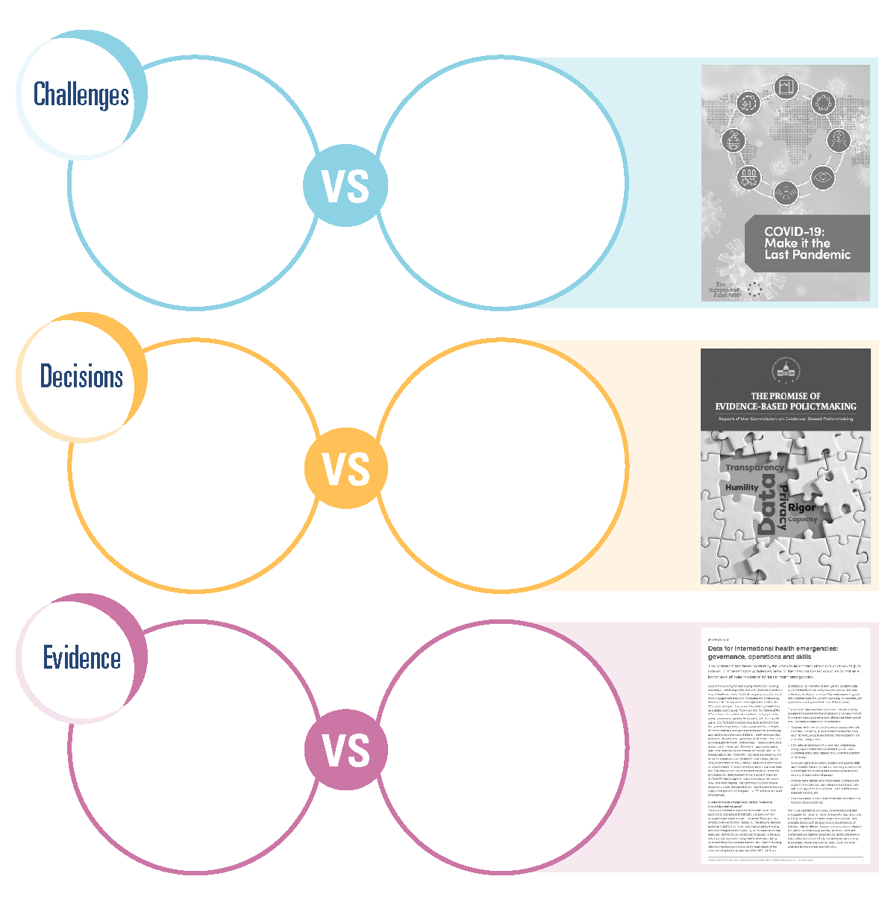
1.4 How the commission builds on and complements past work
Focusing on
single categories
of challenges like pandemics (as did the Independent Panel on Pandemic Preparedness
and Response)
Prepare for different types of societal challenges
Targeting
single types of decision-makers
like government policymakers (as did the Commission on Evidence-based Policymaking)
Recognize distinct needs of different types of decision-makers
Consider complementarities of different forms
of evidence
Prioritizing single evidence sources like data analytics (as did the G7 Science Academies)
1

